Slide 1
JPET STORE
Performance Test POC Report
HMS
Project Manager:
Prepared By: S.Jayanth Reddy
Version :v1.0
Publish Date :23/05/2024

Slide 2
LR Details
Protocol : Web (HTTP/HTML)
LR : 2023R1
Controller : Trial Version

Slide 3
Agenda
Performance Testing Overview
  Key Objective
  Key Scenarios and objective of each scenario
  Approach/Success criteria
Results & Findings
  Results
  Key observations
Script

Slide 4
Performance Testing Overview
Key objective
Overall objective of the JPET STORE Performance testing was to test the behavior of the JPET STORE application performance testing to ensure that it meet the defined performance objectives.

Slide 5
Key Scenarios and objective of each scenario
Business process | No. Of conc. Users | Business Flow
Navigate Application | 1
Launch the Application

Slide 6
Test Approach and Success Criteria
Approach
  Start the Load Test with running 1 user load in LR
  Success Criteria
  Able to capture the application with HTTP/HTML and Execute in LR

Slide 7
Test Results & Graph

Slide 8
Test Results along with Response Times LR
Transaction Name | Minimum | Average | Maximum | St.Deviation | 90 percent
JPET_T01_Launch | 0.903 | 1.197 | 2.63 | 0.383 | 1.205

Slide 9
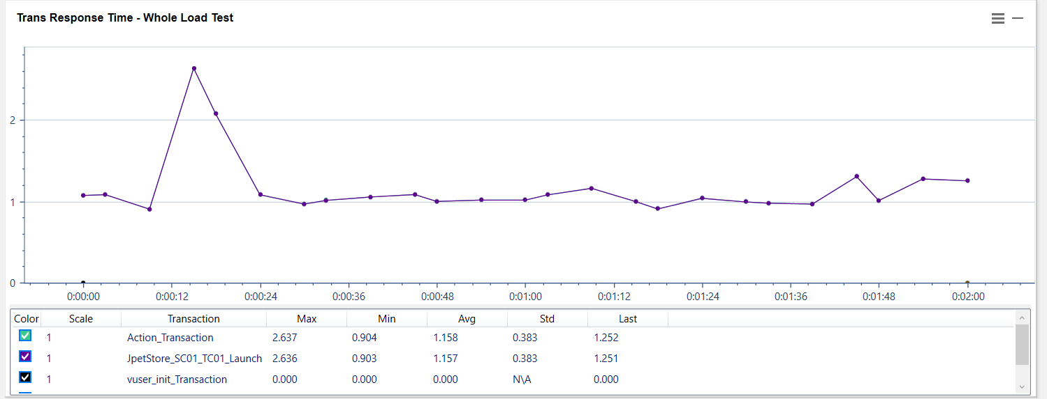
Transaction Response Time Graph LR

Slide 10
Observations
Load runner is able to record the communication with http/html protocol to launch the JPET STORE application successfully.

Slide 11

  Script

